Slide 1

Node.js
Introduction to node.js platform and basic concepts of node.js usage and programming

Slide 2
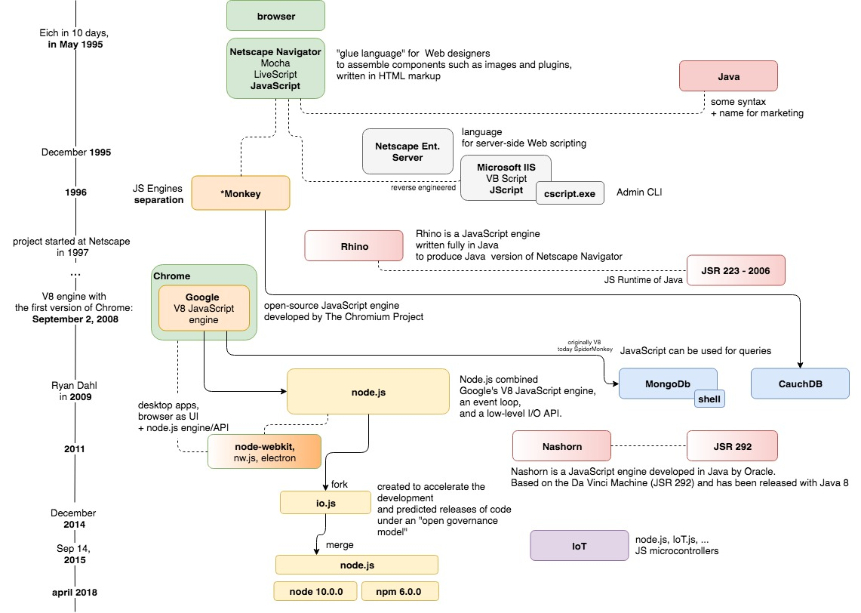




node.js – historický význam
Boli browsre a JS v browsroch
2008 – vznikol node.js ako platforma pre web server v JS
Umožnil vznik ďalších typov aplikácií v JS
npm – largest module registry

Slide 3
What is node.js
Čo je node.js:
Načo je (bol vymyslený):
Server Side JavaScript
Built on Google‘s V8
Evented, non-blocking I/O.
Module System (CommonJS and ES)
To provide a purely evented, non-blocking infrastructure to script highly concurrent programs (web servers,...)
The API should should be fammiliar to client side JS programmers and old school UNIX hackers
Ryan Dahl: Introduction to Node.js, https://www.youtube.com/watch?v=M-sc73Y-zQA

Slide 4
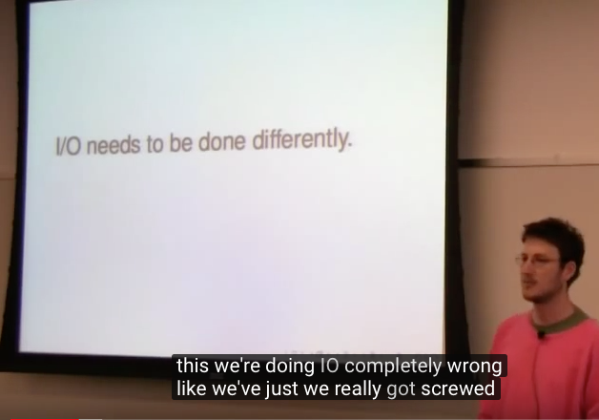
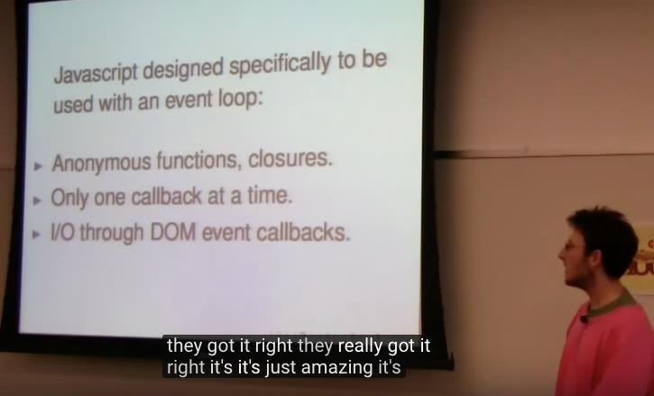
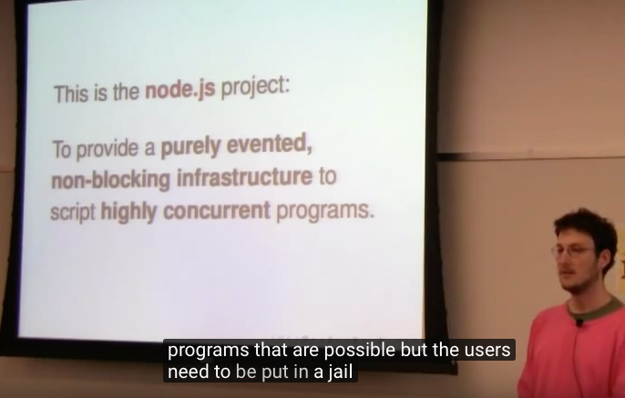
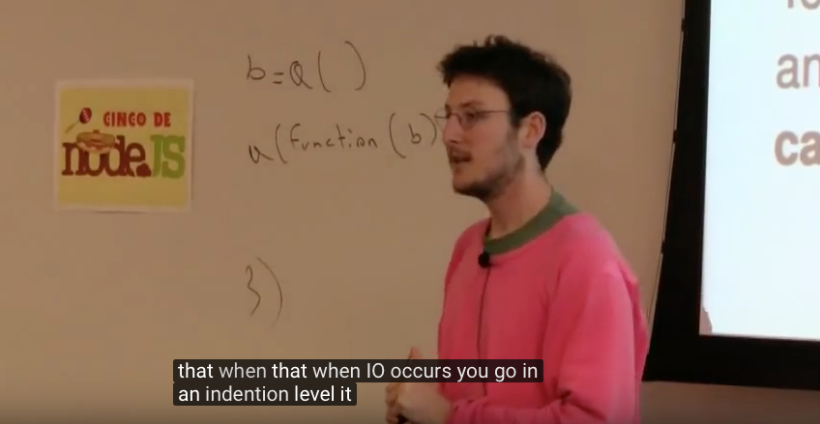
What is node.js (in 4 pictures)
Ryan Dahl: Introduction to Node.js, https://www.youtube.com/watch?v=M-sc73Y-zQA
Notes:
1. IO treba robit bez blokingu. IO treba robit cez eventy a callbacky a nie cez thready
2. JS je presne na toto vhodny jazyk, presne tak sa uz dneska koduje UI (cez eventy), a JS ma na to vsecko co potrebujeme, anonymne funkcie, closures, vykonava len jednu funkciu naraz (netreba riesit synchronizaciu)
3. Takze na zaklade toho si vybral JS ako ten vhodny jazyk na novu platformu pre ulohy vyzadujuce “vela IO operazii subezne“
4. a eventy a callbacky si vybral ako paradigmu pre „syntax takehoto programovania“

Slide 5
What is node.js
Prečo bol vymyslený:
IO needs to be done differently,
Threaded concurrency is a leaky abstraction
Why is not everyone using event loops, callbacks and non blocking IO ?
Prečo Java Script:
Anonymous functions, closures
Ony one callback at a time
DOM Events („I/O“ in browser)
Design Goals (original R.D.):
No function should directly perform IO
To receive info from disk, net or another process, there must be callback
Stream everything, never force buffering of data
Have build-in support for most important protocols TCP, DNS, HTTP
Ryan Dahl: Introduction to Node.js, https://www.youtube.com/watch?v=M-sc73Y-zQA

Slide 6
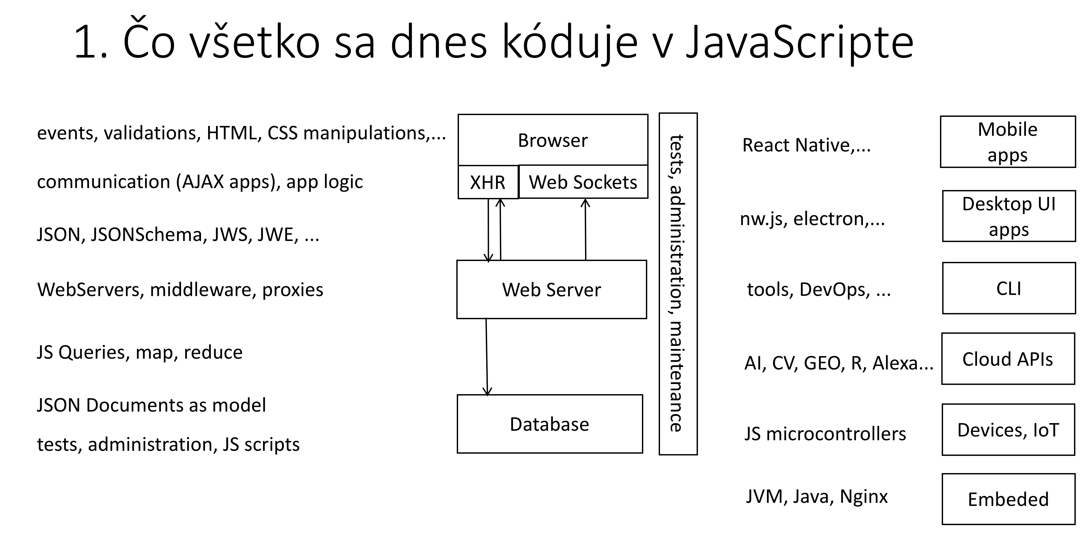
What is node.js
MDN Definition
Prax
Node (or more formally Node.js) is an open-source, cross-platform, runtime environment that allows developers to create all kinds of server-side tools and applications in JavaScript.
The runtime is intended for use outside of a browser context (i.e. running directly on a computer or server OS). As such, the environment omits browser-specific JavaScript APIs and adds support for more traditional OS APIs including HTTP and file system libraries
open source: https://github.com/nodejs/node
cross platform: Linux, OSX, Windows, SunOS AIX on Power Series, Linux on Power Series, Linux on System z
all kinds of apps:

Slide 7
node.js platform
Introduction to node.js architecture and basic concepts of node.js usage and programming

Slide 8
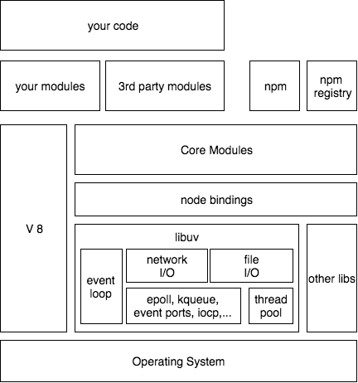
node.js platform
your code is:
written in JavaScript language
one starting file (index.js, server.js, app.js)
Run by V8 engine

Slide 9
node.js platform
V8 is Google’s
open source
high-performance JavaScript engine
written in C++
used in Google Chrome, node.js and others
V8 Design Elements
just-in-time (JIT) compilation
Fast Property Access
Dynamic Machine Code Generation
Efficient Garbage Collection
https://github.com/v8/v8/wiki/Design-Elements, https://v8project.blogspot.com/2016/08/firing-up-ignition-interpreter.html

Slide 10
node.js platform
your code is using core modules
File I/O
Net I/O, HTTP, TCP,…
Terminal I/O
Other things
remember: JavaScript language has no I/O API

Slide 11
node.js platform
I/O in core modules is implemented in libuv
libuv is a multi-platform support library with a focus on asynchronous I/O. It was primarily developed for use by Node.js, but it’s also used by Luvit, Julia, pyuv, and others.

Slide 12
node.js platform – libuv, event loop
libuv
I/O exposed as single threaded event loop
uses available OS mechanisms for evented IO
blocking OPs performed in thread pool (internally)

Slide 13
node.js platform
node bindings provide access to C binaries from JavaScript
libuv
other libs
http-parser
c-ares
OpenSSL
zlib

Slide 14
node.js platform
your code may use 3rd party modules
packages installed by npm program
downloaded from npm registry

Slide 15
node.js platform
YOUR CODE shell be de-composed to modules as well
CommonJS
ES modules

Slide 16
node.js platform
YOUR CODE can be published
to npm registry
using npm
you can reuse
others can reuse

Slide 17
node.js platform - Recap
node.js je google V8micka - tam beží všetok Váš JS kód, aj všetok node.js JS kód aj všetok JS kód externých modulov
zvyšok je hrča C-čkového kódu, dnes už prevažne poextrahovaná do samostatných knižníc, používaných aj inde
Event loop (súčasť libuv) je mechanizmus, ktorým sa zabezpečuje jednothredové vykonávanie callbackov z async operácií na v8 stacku
npm je repository a tooling na inštalácie a publikovanie modulov

Slide 18
Core Modules and APIs

Slide 19

Core Modules and API
Aby sme niečo užitočné naprogramovali, potrebujeme okrem základného JS aj nejaké užitočné moduly a musíme sa naučiť ich API
+ mali by sme rozumieť čo je JS a čo je už „externé API“

Slide 20
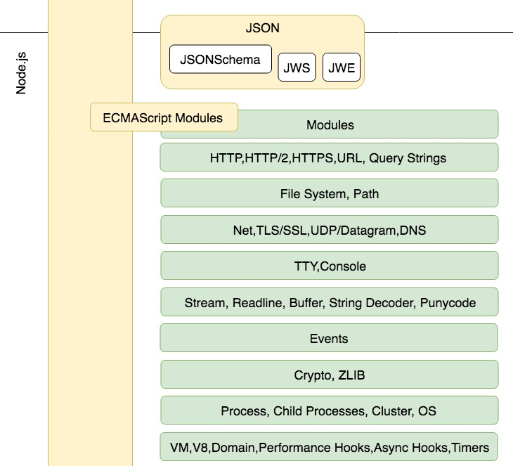
Core Modules and APIs
38 modules
3 deprecated
5 experimental
30 modules
http
filesystem
streams
events
...
(v 11)

Slide 21
node.js Core Modules and APIs
Functionality:
networking
http
tcp,ipc,udp,dns
filesystem
processes
Concepts:
events
stream
buffer
promises
Support:
functionality
zlib, crypto, ...
code and runtime
module, .. inspector
url
http
events
module
query_string
http2
vm
https
timers
assert
crypto
util
tls
net
dgram
buffer
repl
zlib
dns
stream
string_decoder
async_hooks
path
fs
readline
perf_hooks
fs.promises
promises
trace_events
os
child_process
inspector
console
tty
process
worker_threads
cluster

Slide 22
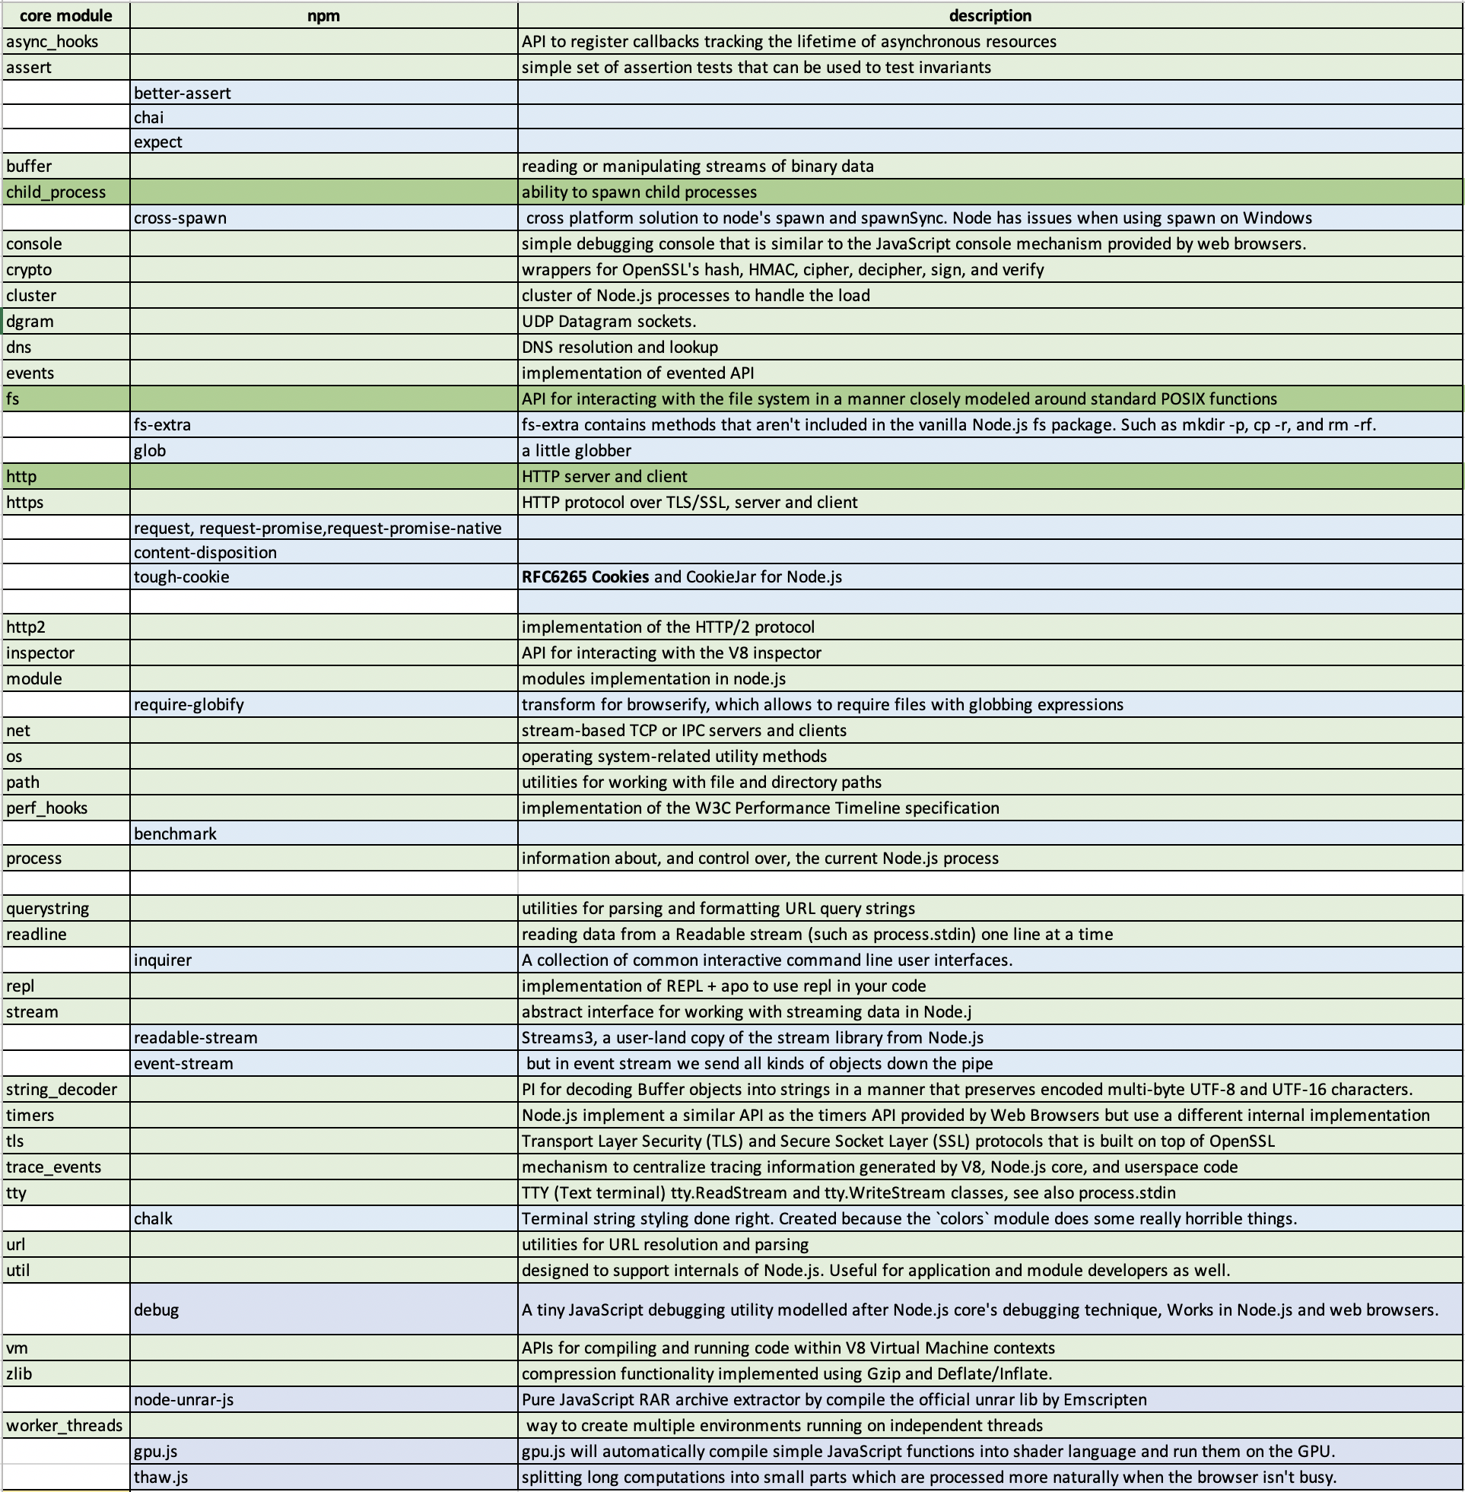
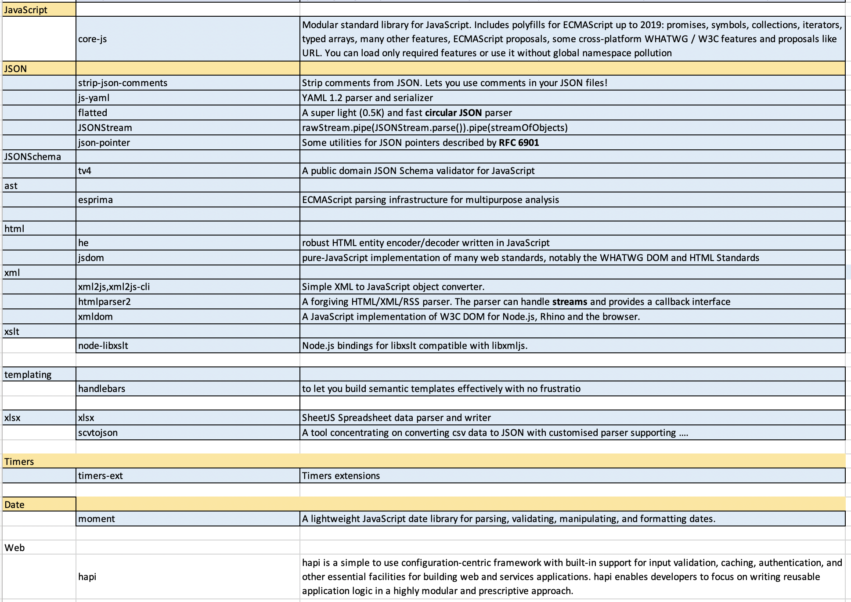
node-core-modules.xlsx
.............

